Slide 1
What makes a nation susceptible to COVID-19 fatalities?
Capstone Project for Data Scientist Bootcamp @ Springboard
Dr. Lisa Hahn-Woernle, August 20, 2020

Slide 2
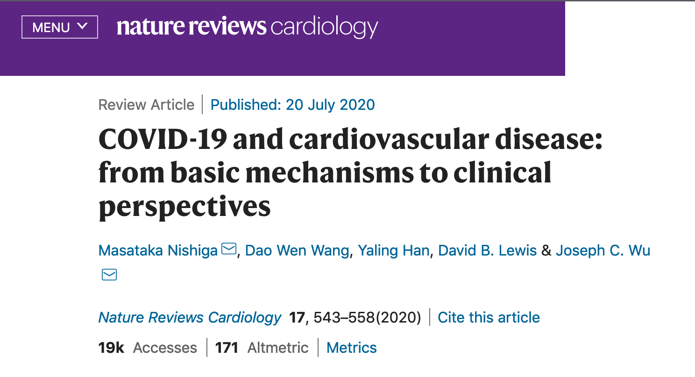
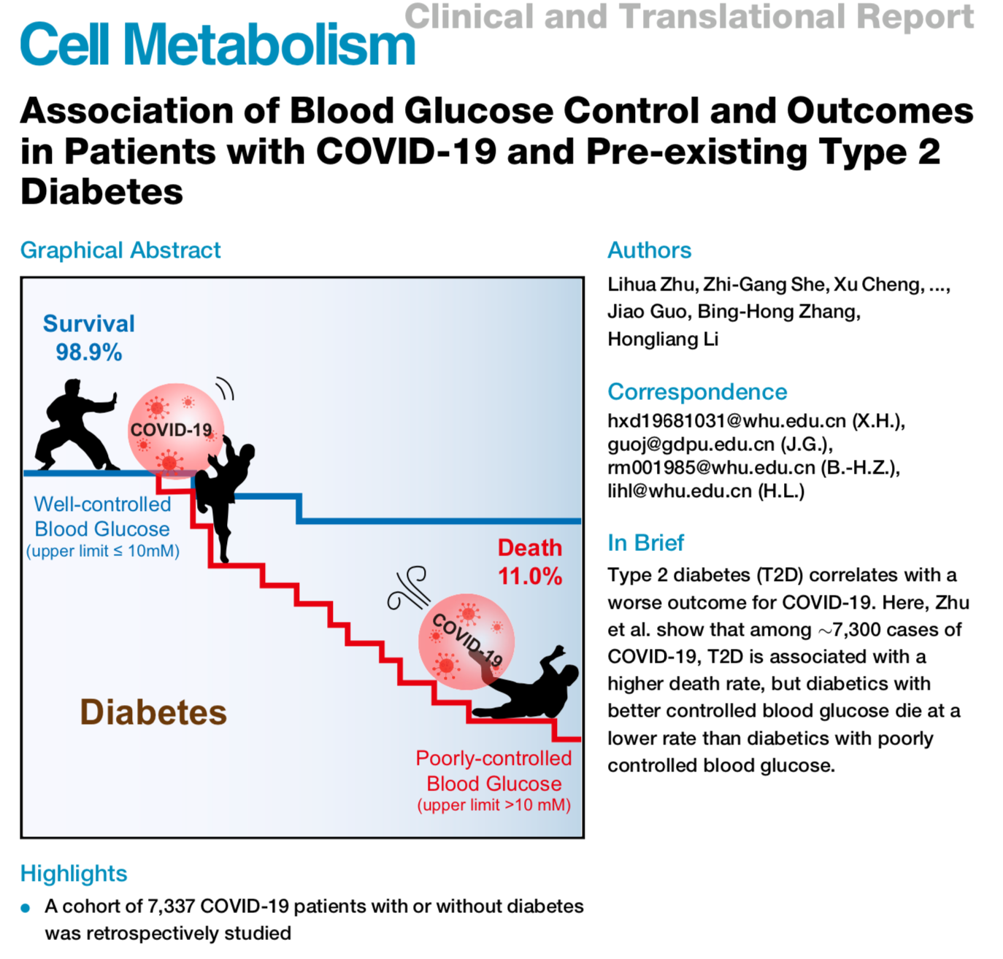
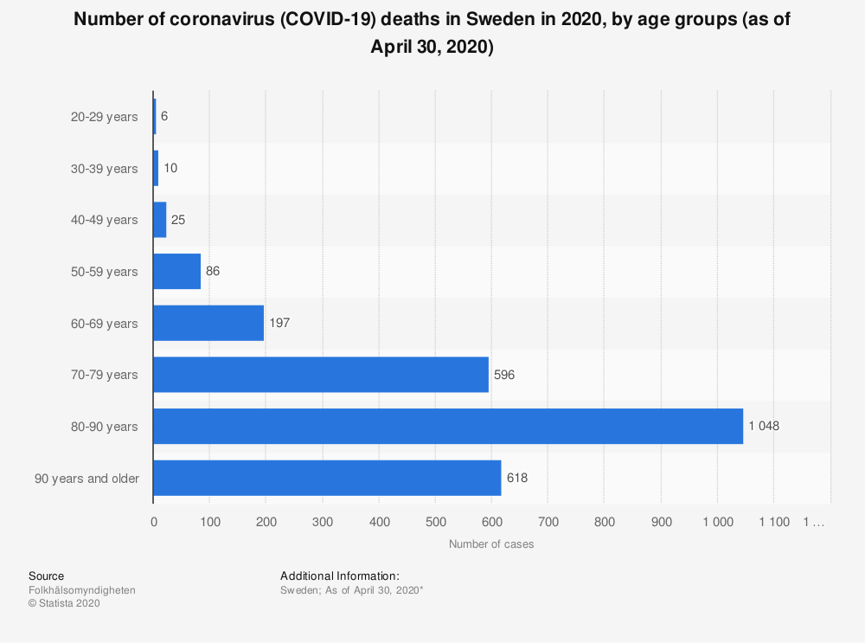


Slide 3

Using
Machine Learning Techniques,
can we identify a correlation of
COVID-19 fatalities
to
health statistics and demographics?

Slide 4
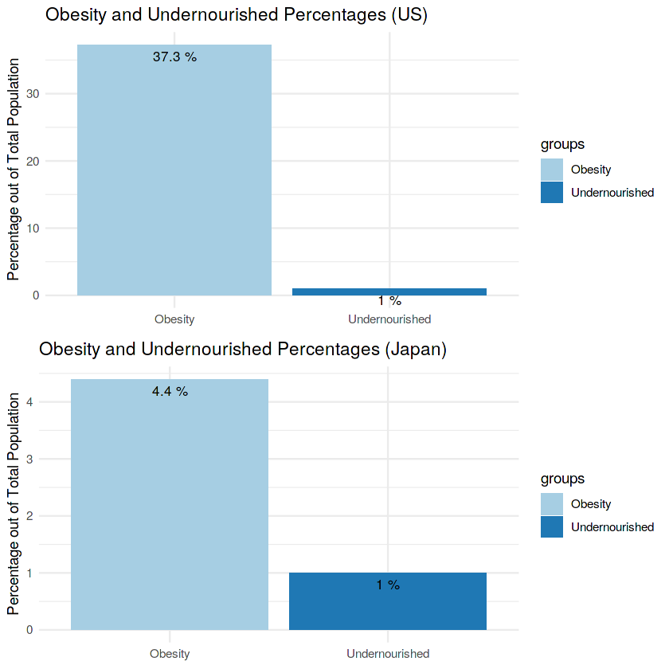
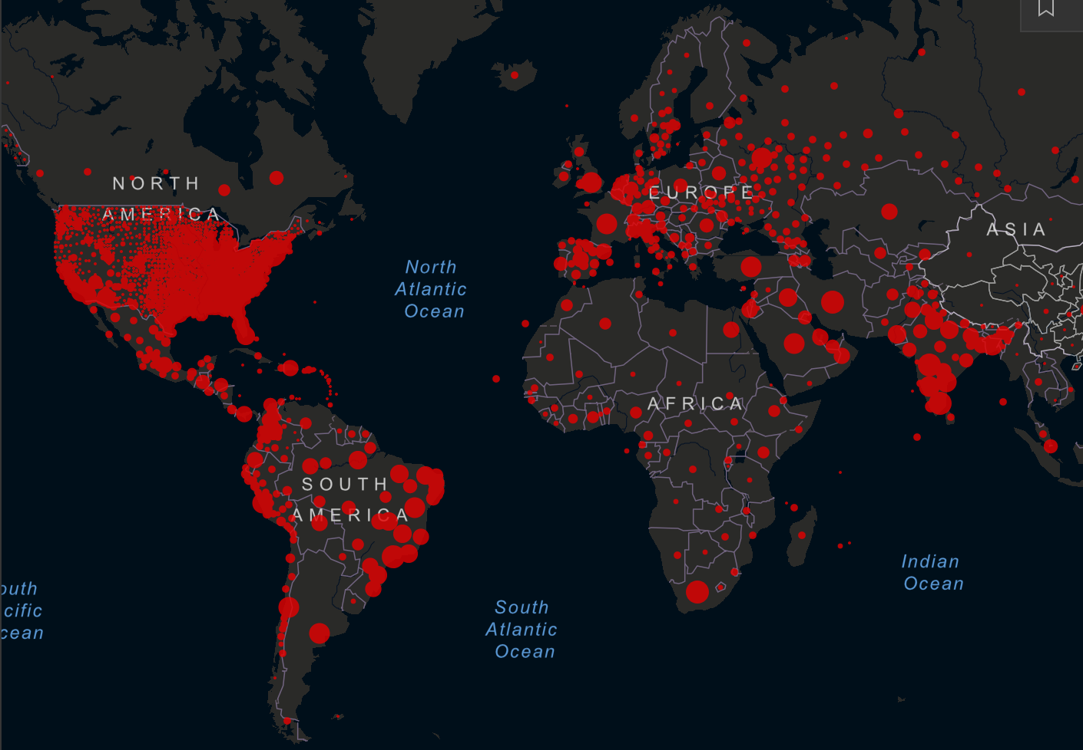


The Data
COVID-19: Confirmed and Deaths
Johns Hopkins University, May 9, 2020
Nourishment: Undernourishment and Obesity
Kaggle, 2016 records
Health: Cardiovascular Disease and Diabetes
Our World in Data, 2017 records
Aug 17, 2020

Slide 5
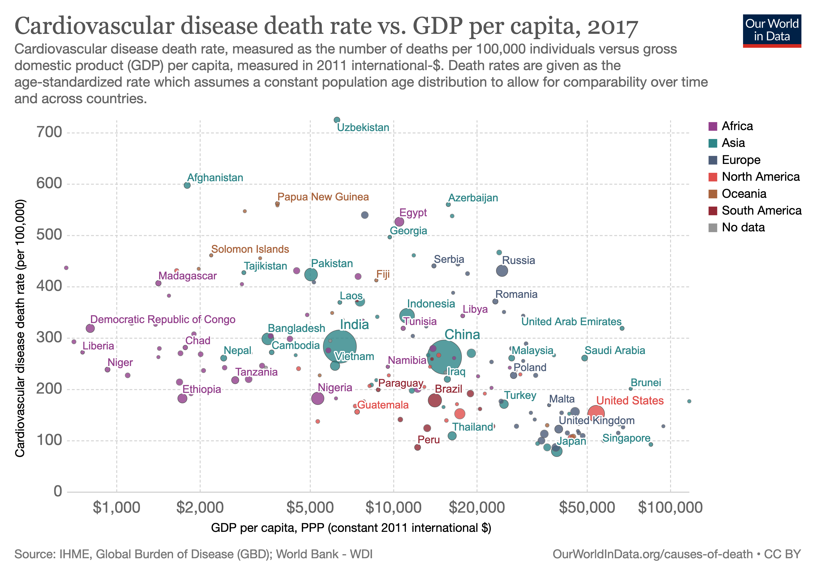

Slide 6
The Data
COVID-19: Confirmed and Deaths
Johns Hopkins University, May 9, 2020
Nourishment: Undernourishment and Obesity
Kaggle, 2016 records
Health: Cardiovascular Disease and Diabetes
Our World in Data, 2017 records
Demography: Population and Males/Females 75+
United Nations, 2019 records

Slide 7
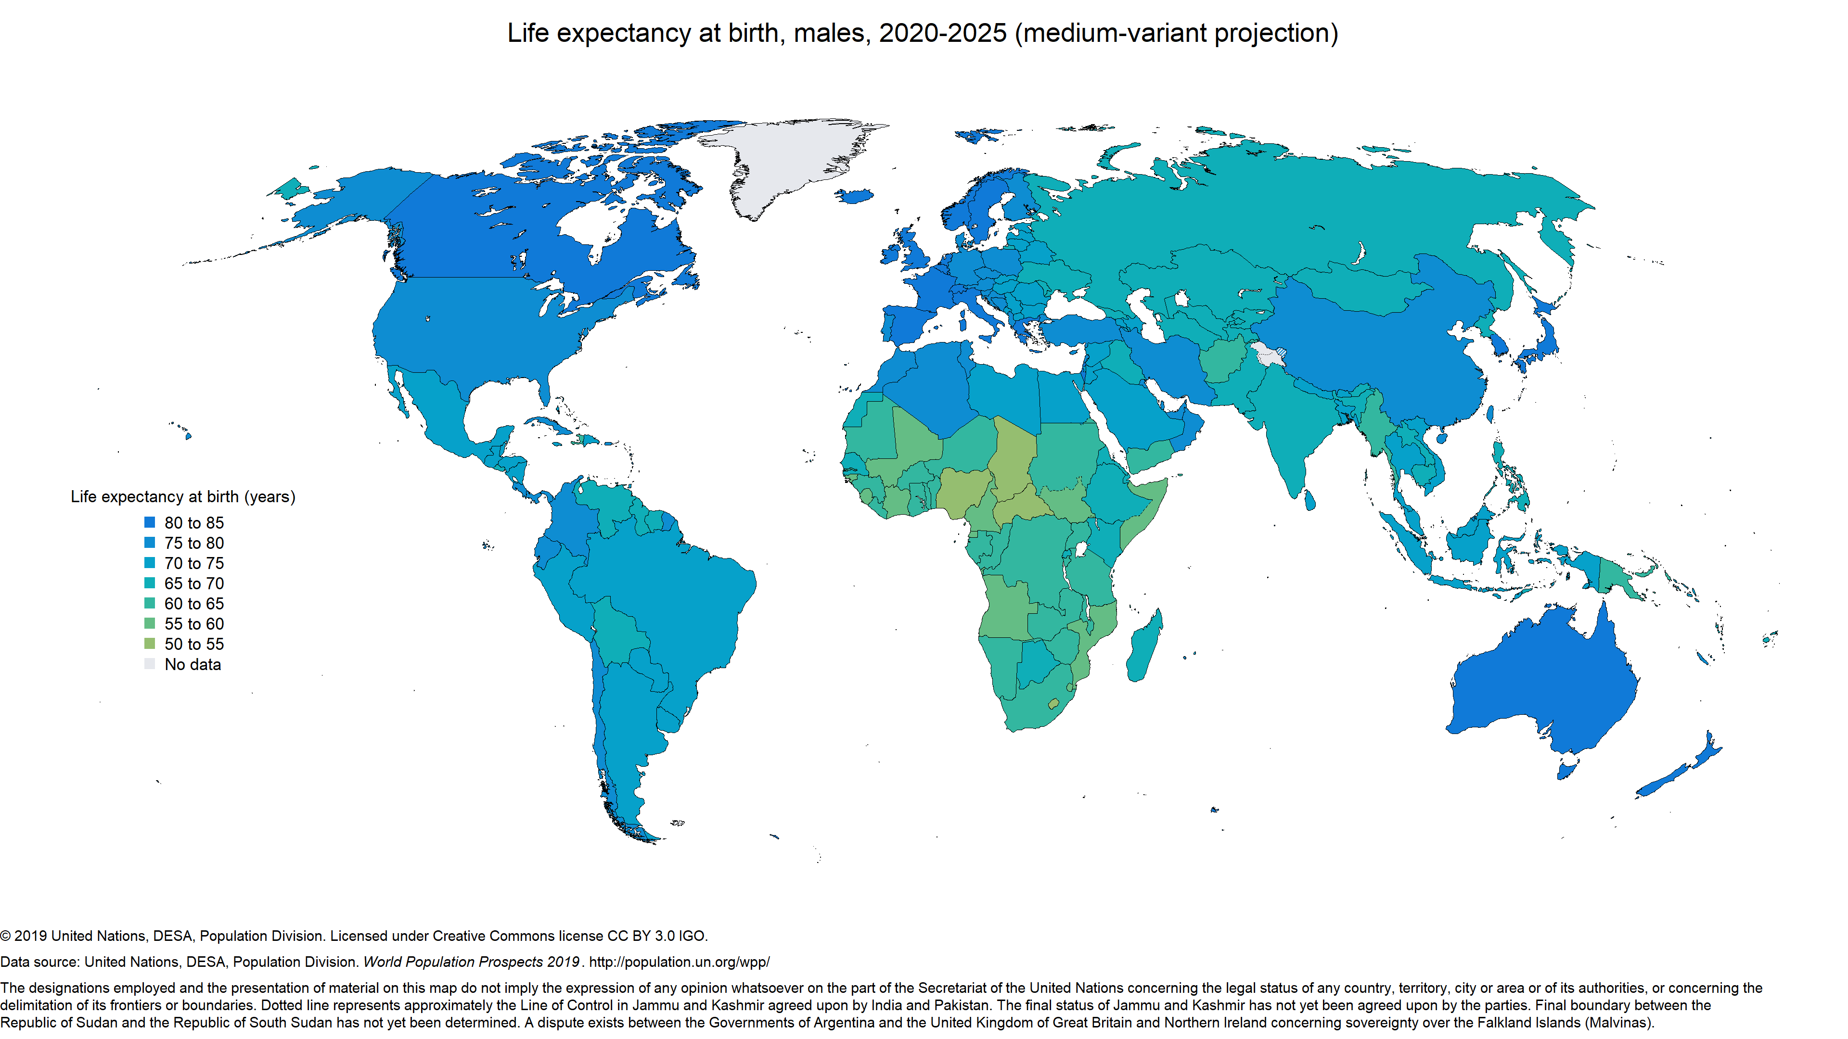

Life expectancy for males
Males

Slide 8
Health
Demografics
Males
?
??
?
Which story tells the data?
?
Nourishment
COVID-19

Slide 9
Exploring the data set

Slide 10
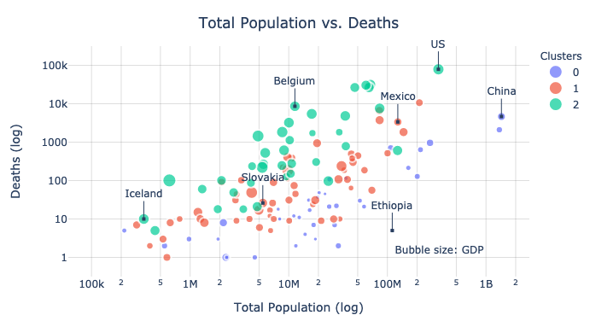
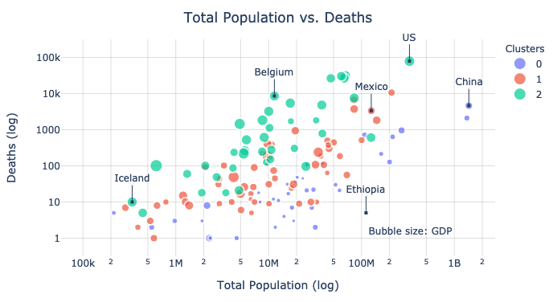
The bigger, the more - the richer, the worse.
*
* May 9, 2020

Slide 11
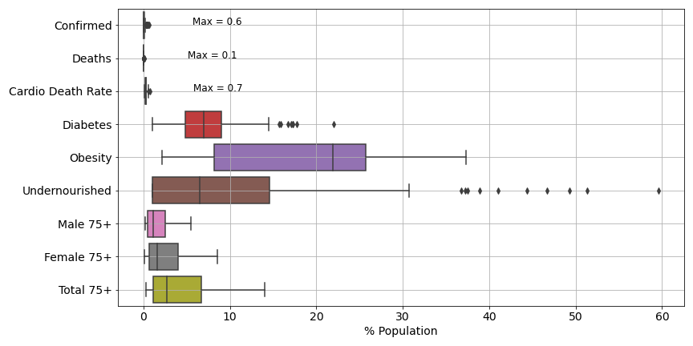
How common are COVID-19 fatalities compared to … ?

Slide 12
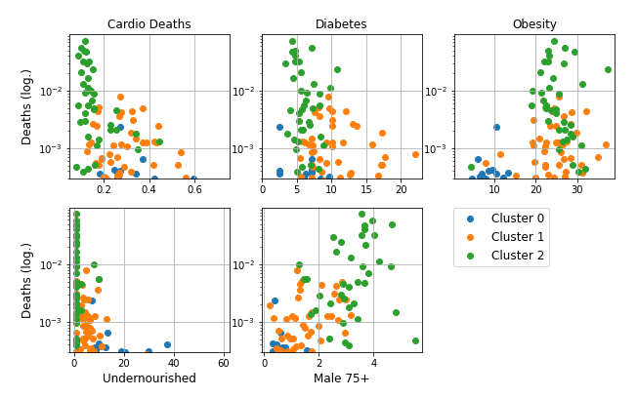
Are COVID-19 fatalities related to health or age?
All data in unit
% Total Population Size

Slide 13
Are COVID-19 fatalities related to national health or age?
Low Cardio Deaths
Low Diabetes
High Obesity
No Undernourishment
Many 75+ Males
All data in unit
% Total Population Size

Slide 14
Modeling
Data Set
Supervised Learning
Regression Models
Confirmed COVID-19
Cardiovascular death rate
Diabetes
Obesity
Undernourishment
Males 75+
Total population size
Clusters 1 & 2
COVID-19 Deaths
2nd Degree Polynomial
110 Countries
37
Training
Testing
2nd Degree Polynomial
Decision Tree
Standardize and scale
147 Countries
Confirmed COVID-19
Cardiovascular death rate
Diabetes
Obesity
Undernourishment
Males 75+
Total population size
Clusters 1 & 2
COVID-19 Deaths
Random Forest
Gradient Boosting

Slide 15
What motivates the choice of models?
The data:
Continuos, no classifications, complete (no new information available)
Small (147 countries and 9 features)
The question:
What features are important?
Focus on fitting, not prediction
Understandable, cheap
Expects 2nd degree polynomial, likely to overfit
great for non-linear feature relationships
work better on large data sets
more accurate than DT, less prone to overfitting
data set might be too small
learns from each previous DT
more prone to overfitting
2nd Degree Polynomial:
All Decision Tree (DT) based models:
Random Forest:
Gradient Boosting:

Slide 16
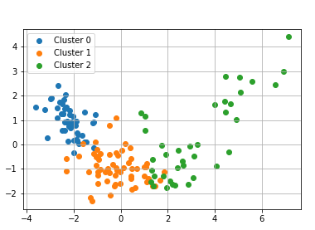
2nd Degree Polynomial Regression
General form:
$f(\overset{⃗}{x})=\overset{N(i≤j)}{\underset{i,j}{∑}}[a_{i,j}⋅x_{i}⋅x_{j}]+\overset{N}{\underset{i}{∑}}[b_{i}⋅x_{i}]+c$
Principal Component Analysis

Slide 17
2nd Degree Polynomial Regression
$$f(x)={\text{Cluster}}_{2}⋅\left(\begin{aligned}+1.28\text{Undernourished} \\ -1.15\text{Confirmed} \\ -0.79{\text{Male}}_{75+} \\ -0.62\text{Diabetes}\end{aligned}\right)+\text{Confirmed}⋅\left(\begin{aligned}+0.72{\text{Male}}_{75+} \\ +0.79\end{aligned}\right)+...$$
COVID-19 Application:
Performance on test set:
The model has a relatively high error while it predicts the variance relatively well.
Mean Square Error: 0.6030
R²: 0.7643

Slide 18
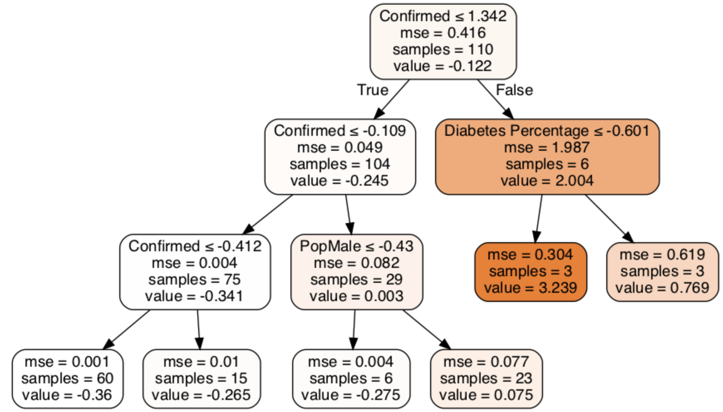
Decision Tree Regressor
Best GridSearchCV result:
max_depth: 3, max_features: 6, min_samples_leaf: 3
Performance on test set:
Mean Square Error: 1.0010
R²: 0.6088
Feature importance: 76.3 %
max_depth: 3
max_features: 6
min_samples_leaf: 3
22.3 %
Depth 1
1.4 %
Depth 2
Not as accurate as Polynomial Regressor
Depth 3

Slide 19
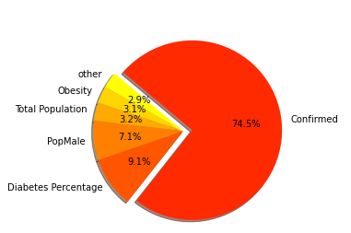
Random Forest Regressor
Best result for n_estimators = 250
Performance on test set:
Mean Square Error: 0.7233
R²: 0.7173
Computational time:
Time to fit: 0.520 sec
Time to predict: 0.026 sec
Feature importance

Slide 20
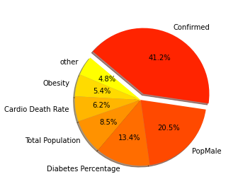
Gradient Boosting Regressor
Best result:
max_depth: 3, max_features: 3, n_estimators: 150
Performance on test set:
Mean Square Error: 0.7778
R²: 0.6961
Computational time:
Time to fit: 0.087 sec
Time to predict: 0.0001 sec
Feature importance

Slide 21
Model Comparison
Model | MSE | R² | Sec. to fit | Sec. to predict
Polynomial | 0.6030 | 0.7643 | 0.0141 | 0.0031
Decision Tree | 1.0010 | 0.6088 | 0.0346 | 0.0094
Random Forest | 0.7233 | 0.7173 | 0.5202 | 0.0264
Gradient Boosting | 0.7778 | 0.6961 | 0.0878 | 0.0017
Best performing model
Worst performing model
Accurate but slow
Relatively accurate and fast

Slide 22
Modeling Insights
Confirmed
Cluster 2
Total Population
Male 75+
Diabetes
Under-nourished
Important Features for Gradient Boosting
Important Features for Polynomial Regression
Important Features for ALL models

Slide 23
Using
Machine Learning Techniques,
can we identify a correlation of
COVID-19 fatalities
to
health statistics and demographics?
YES, we can.

Slide 24
Conclusions
Each data set (COVID-19, health statistics and demographics) contributed to the predictive power of the models.
The Polynomial Regression Model provided the best results out of 4 supervised regression models.
For the Polynomial Regression Model, the cluster with the highest cases and the wealthiest states was a highly relevant feature.
The top 3 important features for ALL models were:
Confirmed COVID-19 cases
Diabetes rates
Males of age 75 and older

Slide 25
Open Questions
Confirmed COVID-19 cases
Diabetes rates
Males of age 75 and older
Do age and diabetes rates actually affect COVID-19 fatalities? Or are they just correlated to a different country-specific feature that is not captured in this study?
Given the current day COVID-19 statistics, how would these results change?

Slide 26

Thank you for your attention.
Questions?

Slide 27
Resources
Jupiter notebooks and documentation to this study: https://github.com/Lisalottel/Springboard/tree/master/Capstone_02
COVID-19 Data base: https://github.com/CSSEGISandData/COVID-19
Cardiovascular disease and diabetes prevalence: ourworldindata.org
Obesity and undernourishment: https://www.kaggle.com/mariaren/covid19-healthy-diet-dataset
Demographics: https://population.un.org/wpp
Modeling and statistic tools: https://scikit-learn.org/stable/index.html

